Slide 1
Health Care Without Rationing or Deficits: The National Right to Life Alternative to Obamacare
National Right to Life Committee
Washington DC, SEPTEMBER 2015
Burke J. Balch, J.D. – Director, Robert powell center foR medical ethics
Jennifer Popik, J.D.

Slide 2
Rationale for Alternative
Why America can afford unrationed health care
why financing health care subsides from general tax revenue doesn’t work

Slide 3
**The HC, food, clothing & shoes, housing, and combination charts are versions, derived from updated data, based on Figure 4.3 in Sherry Glied, Chronic Condition: Why Health Reform Fails (Cambridge MA & London: Harvard Univ. Press, 1997), p.103.
Data Source: (CEA 1991, 2013.) Available at http://origin.www.gpoaccess.gov/eop/tables10.html

Slide 4
Food, Clothing & Shelter Combined as a % of the Family Budget

Slide 5
What the Family Spends on 1. Essentials and 2. Essentials & Healthcare Combined

Slide 6
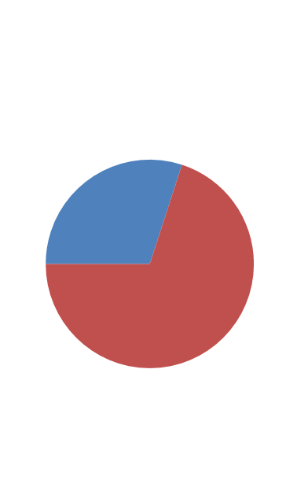
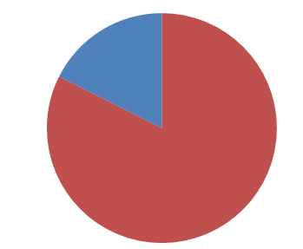
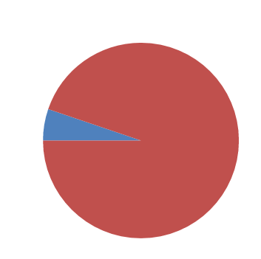
American Health Expenditures and
Per Capita Gross Domestic Product
2040
2013
1960
30%
17.2%
82.8%
70%
94.7%
5.3%
76 % Increase for Non-Health Expenditures
279 % Increase for Non-Health Expenditures
Health Expenditures
Non-Health Expenditures
Sources: available on request to bbalch@nrlc.org
Notes:
Sources: available on request to bbalch@nrlc.org
1960 and 2012 Health Expenditures: https://www.cms.gov/NationalHealthExpendData/downloads/tables.pdf
2040 Health Expenditure Prediction: http://www.nber.org/papers/w14361.pdf
2040 GDP prediction: http://www2.goldmansachs.com/our-thinking/
1960
GDP 1960: 520531000000*100/[100-5.3 hc spending]=
492942857000
2009
GDP 2009:141190000000 * 100/[100-17.6 hc spending] =
116340560000
76.4% increase in non health care
2010
Est. GDP 298230000000 * 100/[100-30hc spending]
208761000000
279% increase in non health care

Slide 7
Conclusions
NOT that American health care system is ideally efficient and can’t be improved
BUT if improvements are made in cost-effectiveness, we shouldn’t necessarily expect growth in health care spending to abate – we might just get more and better health care
CAVEAT: Government-imposed limits could artificially prevent Americans from putting resources into health care that they otherwise could and would do
BOTH Obamacare AND some proposed alternatives seek to do so

Slide 8
Bottom Line:
As long as American productivity keeps increasing (in the long term), the American economy can afford to continue to increase the resources used to save lives and preserve health

Slide 9
Real problem:
Providing safety net for those whose incomes are not average, and its implications for government budgets

Slide 10
The Real Problems
Distribution of income increases not equal
Those with less-than-average income increases have genuine difficulty coping with health care cost increases
Number of uninsured rises among low income

Slide 11
**The HC, food, clothing & shoes, housing, and combination charts are versions, derived from updated data, based on Figure 4.3 in Sherry Glied, Chronic Condition: Why Health Reform Fails (Cambridge MA & London: Harvard Univ. Press, 1997), p.103.
Data Source: (CEA 1991, 2013.) Available at http://origin.www.gpoaccess.gov/eop/tables10.html

Slide 12
The Real Problems
GOVERNMENT ACTS TO HELP: Medicaid, CHIP, now PPACA
BUT

Slide 13
The Problem with Financing Health Care Subsidies from General Revenues
Productivity increases in non-health sectors of whole economy allow more resources for health care
BUT non-health sectors of gov’t budget DON’T see similar productivity increases
General fund government revenue (taxes) can’t keep up

Slide 14
What the Family Spends on 1. Essentials and 2. Essentials & Healthcare Combined

Slide 15
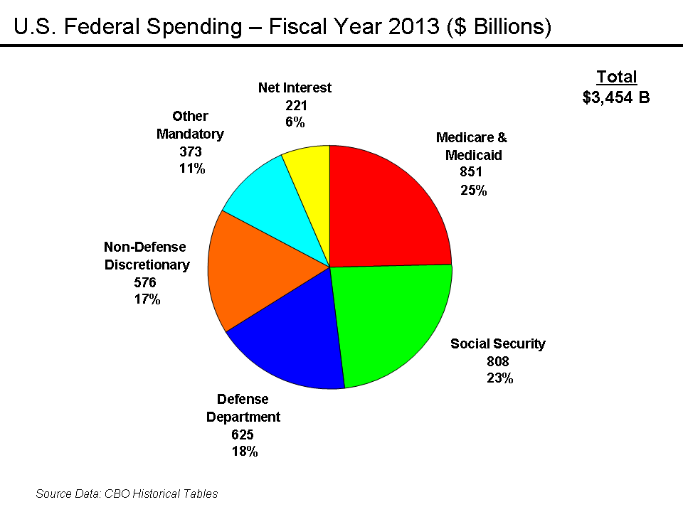

Slide 16
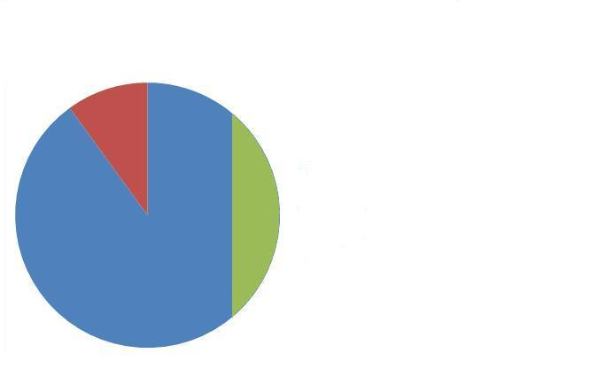
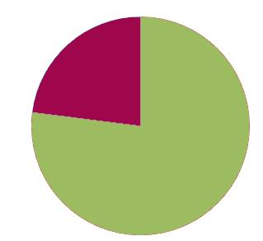
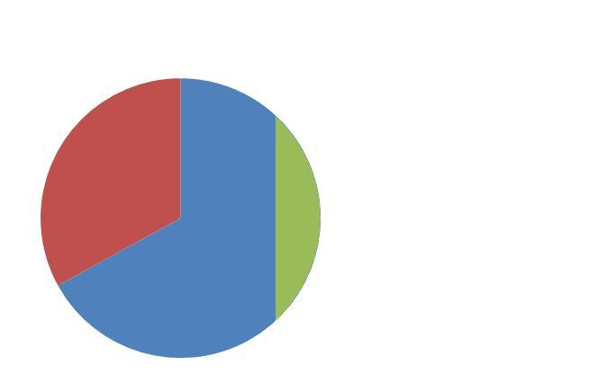
PRIVATE SECTOR SPENDING- GDP
GOVT. SPENDING- FEDERAL BUDGET
17.6 % (spent on H.C) 2011
23% (spent on H.C) 2011
15.1% tax rate to fund the Federal Budget
51% growth in economy by 2040
51% growth in government 2040
30% (spent on H.C) 2040
30% (spent on H.C.) 2040
H.C. Deficit – 7%

Slide 17
Disparity Pushes Policy-makers
To limit the unsustainable pressure for ever-higher government health care payments drawn from general fund revenues
Government policy-makers seek to “bend the cost curve” and limit the growth in all HC spending, private as well as public

Slide 18
Understanding Private Sector Cost-Shifting
Faced with unsustainable health care cost increases, government actors tend to avoid unpopular benefit cuts, and focus on limiting the reimbursement rate for health care providers
Many health care providers assert they are then forced to charge higher rates to privately insured patients to make up for what they lose on governmentally insured patients (and on the uninsured EMTALA requires hospital emergency rooms to serve)

Slide 19
Hospital Cost Shifting- The Hidden Tax (as of 2009)
140
120
100 |  |  | 13130
80 |  |  |  |  |  | 90.1% |  |  | 89.0%
60
40
20
0
0 | 10 | 20 | 30 | 40 | 50 | 60 | 70 | 80 | 90 | 100
Payment to Cost Ratio
Cost= Payments
134.1%
Private Payers
36.6%
Medicare
39.4%
Medicaid 15.9%
Percent of Hospital Costs
Uncompensated Care 6.1%
Source: American Hospital Association and Avalere Health, Avalere Health analysis of 2009 American Hospital Association Annual Survey data, for community hospitals, Trendwatch Chartbook 2011, Trends Affecting Hospitals and Health Systems, March 2011, Tables 4.5-4.6 at http://www.aha.org/research/reports/tw/chartbook/ch4.shtml
Notes:
Data for community hospitals, does include dsh payments
Source: American Hospital Association and Avalere Health, Avalere Health analysis of 2009 American Hospital Association Annual Survey data, for community hospitals, Trendwatch Chartbook 2011, Trends Affecting Hospitals and Health Systems, March 2011, Tables 4.5-4.6 at http://www.aha.org/research/reports/tw/chartbook/ch4.shtml

Slide 20
Hospital Cost Shifting- The Hidden Tax (as of 2009)
140
120
100 |  |  | 13130
80 |  |  |  |  |  | 91.3% |  |  | 85.8%
60
40
20
0
0 | 10 | 20 | 30 | 40 | 50 | 60 | 70 | 80 | 90 | 100
Payment to Cost Ratio
130.3%
Private Payers
36.6%
Medicare
39.4%
Medicaid 15.9%
Percent of Hospital Costs
Uncompensated Care 6.1%
Source: American Hospital Association and Avalere Health, Avalere Health analysis of 2009 American Hospital Association Annual Survey data, for community hospitals, Trendwatch Chartbook 2011, Trends Affecting Hospitals and Health Systems, March 2011, Tables 4.5-4.6 at http://www.aha.org/research/reports/tw/chartbook/ch4.shtml

Slide 21
Private Sector Cost-Shifting as a Solution
Key advantage of private sector cost-shifting is that it can grow proportionately with the resources the private sector allocates to health care
I.e., yields a % of what is actually spent on health care

Slide 22
Private Sector Cost-Shifting as a Solution
Regardless of extent to which it presently occurs
Provides a basis for understanding feasibility of providing for those with low incomes without governmentally imposed restraints on growing allocation of private resources to health care

Slide 23
Proposed solution: cost-shifting at the level of the insurer

Slide 24
Proposed Solution to Pay for Increases in Health Insurance Premium Subsidies: Cost-Shifting at the Level of the Insurer
Analogy of high-risk pools for automobile insurance in most states
Insurers pass along costs of subsidizing insurance in premiums for all -- private sector cost-shifting

Slide 25
Proposal in More Detail

Slide 26
Step One: Set Value of Basic Coverage for those deemed to need subsidies
Statute pegs benchmark of subsidized health insurance premium to percentage of weighted average paid in a prior year
Set value of subsidized insurance at statutorily established % of average paid in private sector for health insurance (weighted by # paying each premium) a set number of years before the year for which subsidies are to be provided to low income beneficiaries
(use different averages based on family size, by state or region and other factors)
Example (solely to illustrate concept):
Suppose index year is 3 years prior and 60% is chosen
2014 average family premium approx. $17,000
2017 top limit of subsidized insurance premium would be $10,200
Notes:
Critical point – benchmark NOT pegged to extrinsic factors like general inflation or growth in GDP plus some arbitrary percentage point

Slide 27
Step Two: Use Sliding Scale to Establish Eligibility
Similar to manner in which eligibility for subsidies is established under ACA
Based on income and other factors, determine how much a given individual or family is deemed able to pay for health insurance
Example:
Assume $10,200 benchmark for 2017
One family might be deemed able to pay $5,200 toward the price, being eligible for a $5000 subsidy
Another might be deemed able to pay $8,200, being eligible for a $2000 subsidy

Slide 28
Step Three: Tax–funded Subsidies Held to Existing Level of Gov’t Payment (1)
Gov’t provides vouchers based on existing levels of government subsidies for health care
Going forward, the subsidies are frozen at their nominal value at a given year. They are NOT adjusted for inflation, medical or otherwise
Potentially, there could be a transition period of several years in which tax-funded subsidies continue to increase at a rate of growth that gradually tapers off to zero

Slide 29
Step Three: Tax –funded Subsidies Limited to Existing Level of Subsidy (2)
Example (with transitional taper of growth in gov’t tax-funded subsidy:
Assume 2017 $10,200 benchmark:
For family able to pay $7,200, eligible for $3000 TOTAL subsidy-- gov’t might provide $2900
Leaves $100 gap
Assume 2018 $10,600 benchmark:
For family able to pay $7,200, eligible for $3400 TOTAL subsidy- gov’t now provides $3100
Leaves $ 300 gap

Slide 30
Step Four: Cost-Shifting at the Level of the Insurer (1)
Require health insurers to offer discounted health insurance (to cover gap) to those unable to afford in proportion to insurer’s share of market:
Insurers pass along additional costs – primarily the costs of increases in health care spending -- in higher premiums for all
Example:
Assume 2017 $10,200 benchmark:
For family able to pay $7,200, eligible for $3000 TOTAL subsidy-- gov’t might provide $2900
Leaves $100 gap absorbed by insurer
Insurer, having anticipated this (as a result of the subsidy ceiling having been tied to a prior year health insurance premium average), sets premiums slightly higher across the board to offset loss

Slide 31
Step Four: Cost-Shifting at the Level of the Insurer (2)
Each health insurer required to offer at least one policy with premium at or below benchmark
Allocation of responsibility for subsidies among competing insurance companies:
Those subsidized may choose from among policies offered by all insurers (Can choose policies with premiums higher or lower than benchmark– gov’t subsidy amount same)
Bookkeeping transfers re-allocate costs of insurer discounts to cover gaps among all health insurance companies in proportion to their overall market share
To the extent risk adjustment is deemed necessary to prevent incentives to design plans to “cherry pick” healthy beneficiaries, it would be handled by insurer-to-insurer transfers of funds (rather than variation in gov’t payments)

Slide 32
MEDICARE

Slide 33
Problems Applying Cost-Shifting to Medicare
Instead of current transfer (to those with low income/assets) as in Medicaid, ACA, etc., inter-generational transfer
Sense of entitlement based on having paid payroll taxes during working life
Fiscal 2012 funded:
37% payroll taxes
13% beneficiary premiums
About 50% general tax revenues
CBO, A Premium Support System for Medicare:Analysis of Illustrative Options (Sept. 2013)

Slide 34
Increase in Gov’t Health Care $ Through 204o
Growth in Fed Spending
As % of GDP
Total Growth:
43% Aging
45% increase in HC spending/beneficiary
12% more recipients under ACA
CBO, The 2015 Long-Term Budget Outlook (June 2015)
2.8%(from 5.2% to 8%)
1.2% Aging
1.3% HC increase/ben.
.3 % addt’l recipients

Slide 35
Possible Approach
Use cost shifting at level of insurer to cover increases in health care spending/beneficiary
Continue to rely on general tax revenues to deal with additional costs associated with aging and number of recipients

Slide 36
Possible Approach: Version of Premium Support
Regional basis:
Price of FFS Medicare based on average FFS Medicare costs for average risk beneficiary in market area
Federal tax dollar contribution frozen at nominal price of FFS Medicare in beginning year
(Possible transition period of declining rate of growth over a few years
Result: By freezing federal contribution on a per-beneficiary basis (rather than total $ basis), isolate increases in hc spending/beneficiary to be handled by cost-sharing at level of insurer

Slide 37
Possible Approach: Version of Premium Support
Set benchmark (for purposes of income/asset based subsidies, not federal gov’t $ contribution) at higher of :
Price of FFS Medicare in year from which federal tax dollar contribution frozen
Average bid, weighted by plan enrollment, in a prior index year
Establish income/asset –based eligibility for subsidies based on ability to afford to pay benchmark premium
Require insurers (including FFS Medicare) to offer discounts for gap (proportionate to market share)
Insurers, including FFS Medicare, price cost of covering discount into bids

Slide 38
3 Basic Advantages

Slide 39
1. Free Market, Not Government, Determines GDP % Allocated to Health Care

Slide 40
How Employers/ Individuals Decide
Health insurance too costly – can go bankrupt
Health insurance too meager –
employers can lose workers to competitors/
individuals can get unacceptably inferior health care
Balance costs and benefits

Slide 41
The Virtuous Use of the Free Market
When increases in cost of insuring those who cannot afford it passed on to those who can afford health insurance
Employers (or individuals) unconsciously factor their share of subsidizing those who can’t afford insurance into their cost/benefit balancing

Slide 42
Feedback Loop (1)
Assume that in Year 1, the weighted average family premium in the private sector is $20,000
Assume that, in Year 2, if premiums WEREN’T affected by our proposal, the average family premium would rise to $21,000.
Now assume that to get the same level of insurance with the cost-shifting priced in, the average family premium would need to rise to $21,500.
Perhaps in Year 2 employers and individuals are unable or unwilling to pay that much – so on (weighted) average they accept a somewhat lower level of insurance and the actual average for Year 2 is $21,100

Slide 43
Feedback Loop (2)
Without Insurer Cost-Shifting
With Insurer Cost-Shifting
Year 2 Average: $21,000
Effect on tax-funded subsidies:
1) Gov’t spending rises to keep health insurance for low income in same proportion OR
2) Gap btwn. subsidized & average health insurance widens OR
3) Gov’t suppresses growth of ALL HC spending
Year 2 Average Same Level: $21,500
Year 2 Average Lower Level $21,100
60% of average, setting subsidy ceiling 3 years out, is $12,660 instead of $12,900
BOTH average & future benchmark for subsidized lower insurance
Notes:
On the other hand – very important to Nat’l Right to Life – if because of productivity increases, economic growth, able & willing to spend more, average and benchmark adjust upward accordingly
Most economists focus on the law under which health insurance premiums paid by employers for employees aren’t taxable as distortion of free market allocation of resources btwn HC & other goods & services – but when subsidies for HC come out of general revenue, rather than being directly related to choices for health care spending, THAT is a distortion

Slide 44
ADVANTAGE of using feedback loop and insurer cost-shifting
Growth in overall health care spending, including subsidies for those unable fully to pay for their hc, would be tied to what people who can afford to do so themselves choose to pay for health insurance rather than being tied to government budgets. This:
Keeps health care costs to what people collectively, through individual decisions, decide they can afford to pay
Does not arbitrarily limit health care below what people, through such decisions, are willing and able to pay

Slide 45
Consequence
In the aggregate, America won’t spend more than it can afford on health care
America WILL spend AS MUCH as it CAN afford (and collectively chooses) on health care

Slide 46
What Health Care Economist Sherry Glied Says About a Health Tax Equally Applies to Insurance Cost-Shifting
“[I]t would make the level of sustainable national health spending an outcome of a private-decisionmaking process, not a constraint imposed arbitrarily from above. Health care financing would mimic the dynamic nature of health care itself. Health care revenue would rise when costs rise.”
Chronic Condition: Why Health Reform Fails, p. 221
Notes:
Photo source: http://www.hhs.gov/open/contacts/aspe.html

Slide 47
2. Health Care’s Contribution to Deficit Dramatically Cut

Slide 48
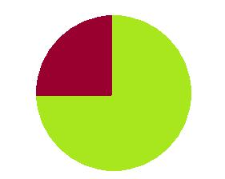
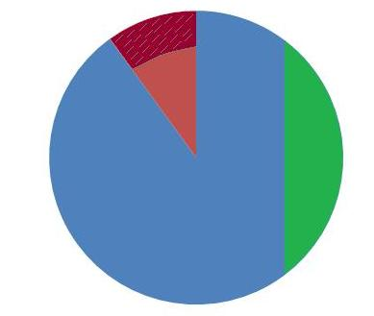
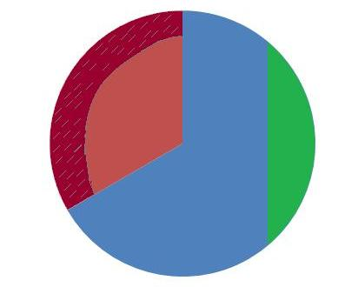
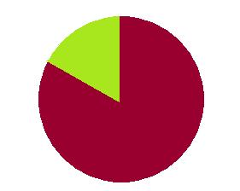
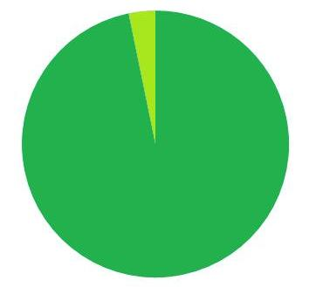
17.2 % (spent on H.C) 2013
X dollar Amount for HC →
15.5% Taxes
Government Expenses
Private Sector Spending GDP
Total Amount for Health Care
30% (spent on H.C) 2040
Same X dollar Amount for HC →
15.5% Taxes
Private Sector Spending GDP
Government Expenses
Total Amount for Health Care

Slide 49
3. Both Efficiency & Quality of HC Largely Set by Market, Not Gov’t

Slide 50
Insurance Cost-Shifting
Availability of competing insurance plans provides better check and balance on denial of needed HC even as it promotes efficient HC

Slide 51
Government’s Role Transitions More to Regulator Than Subsidizer
Government regulates:
Defines value of minimum insurance package that must be available to those with low income (% of average plan’s cost with time lag)
Determines income eligibility for sliding scale premiums
Enforces “rules of the road” -- especially regarding insurance companies’ duty to provide contracted care and “fair share” of discounted insurance, as well as antitrust and other measures to ensure robust competition
Does not finance growth in HC spending out of general revenues:
Coverage of uninsured and those with low income does not depend on income or payroll taxes but on cost-shifting tied to the health insurance people choose

Slide 52
Insurance Cost-Shifting
Most important advantage from pro-life perspective – avoids Obamacare’s official imposition of economically unjustified limit on allocation of resources to health care and consequent rationing of life-saving medical treatment
Alternative to raising taxes on health insurance as a way of subsidizing the uninsured

Slide 53
Summary of NRLC Alternative
Belief that growth in health care spending must be curtailed is WRONG – productivity increases
Real problems: providing safety net for those whose incomes are not average, and its implications for government budgets
Cost-shifting at the level of the insurer can assist those who can’t afford insurance without suppressing health care spending.
Allows free market, not arbitrary gov’t limits, to decide what proportion of resources are devoted to health care
Prevents both spending more than economy can afford on health care AND allows us to spend what we collectively can afford and choose to allocate on saving lives and preserving health

